Slide 1
Rental portal database
REPORT by George chempumthara

Slide 2
AIM OF THE PROJECT
To create robust and efficient portal system where users can rent and occupy a property. A simple yet complex database where we can perform certain functionalities.
Something similar to Zillow and Trulia; Which are essentially portals to handle such requests and data

Slide 3
WHY? ...

Slide 4
OUTCOMES
Real World Relevance
Complex and Challenging
Transaction Handling
User Management
Improving Upon the USAGE of MySQL

Slide 5
SOME RELEVANT ENTITIES…
UserDetails
PropertyDetails
Transactions
Requests
Contracts
RatingsAndReview

Slide 6
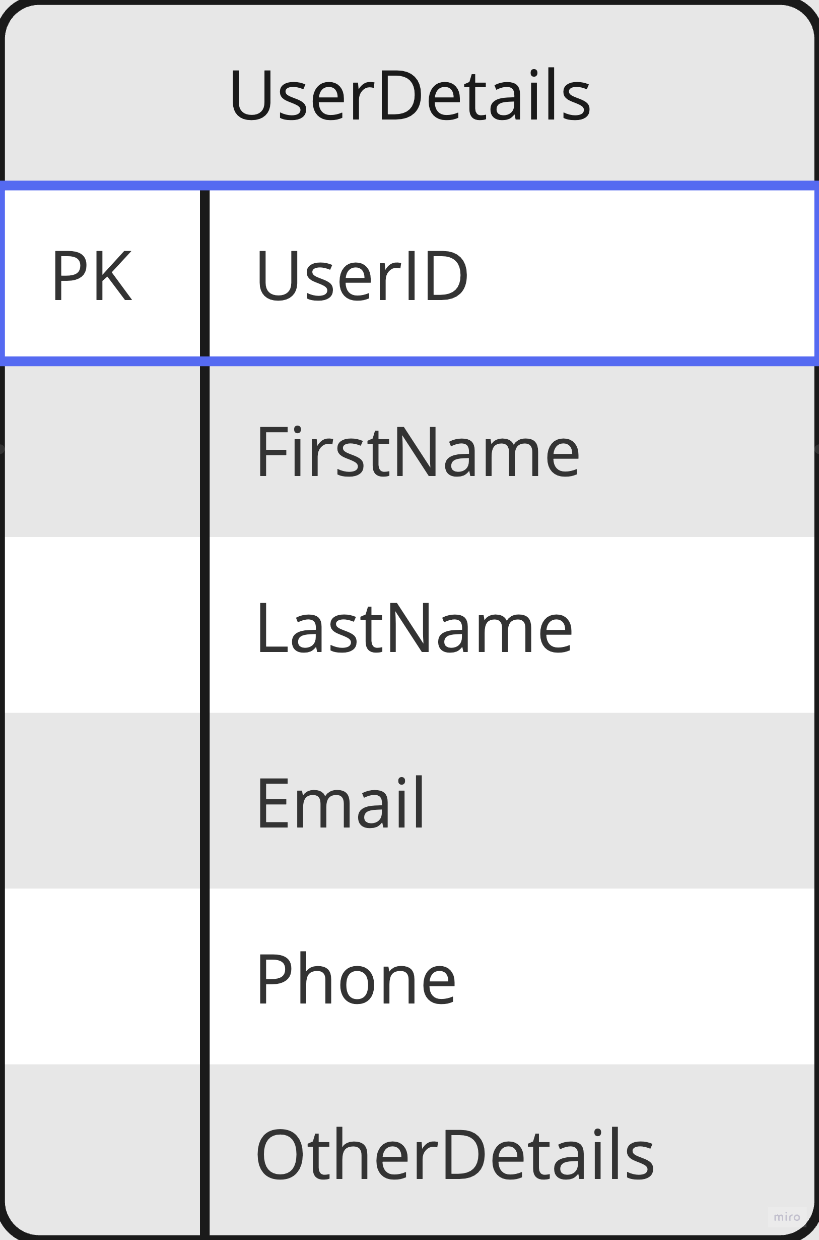
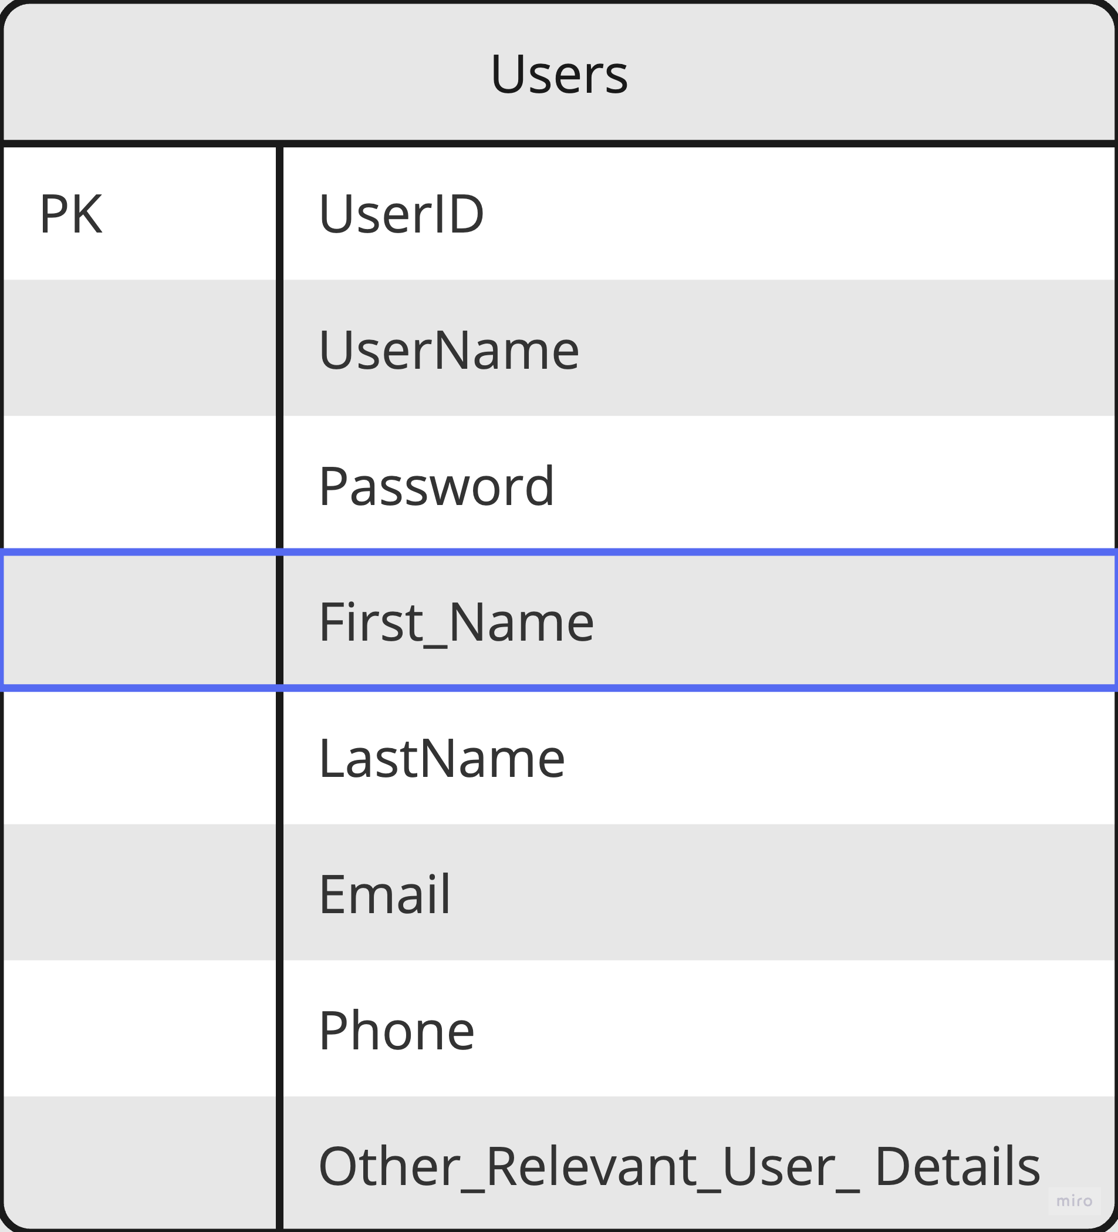
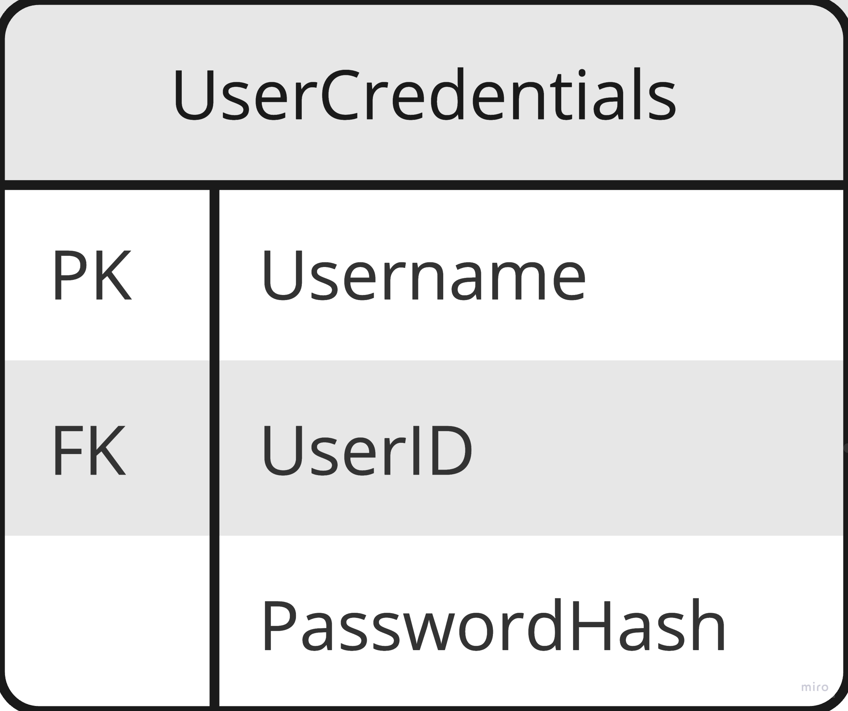

Slide 7
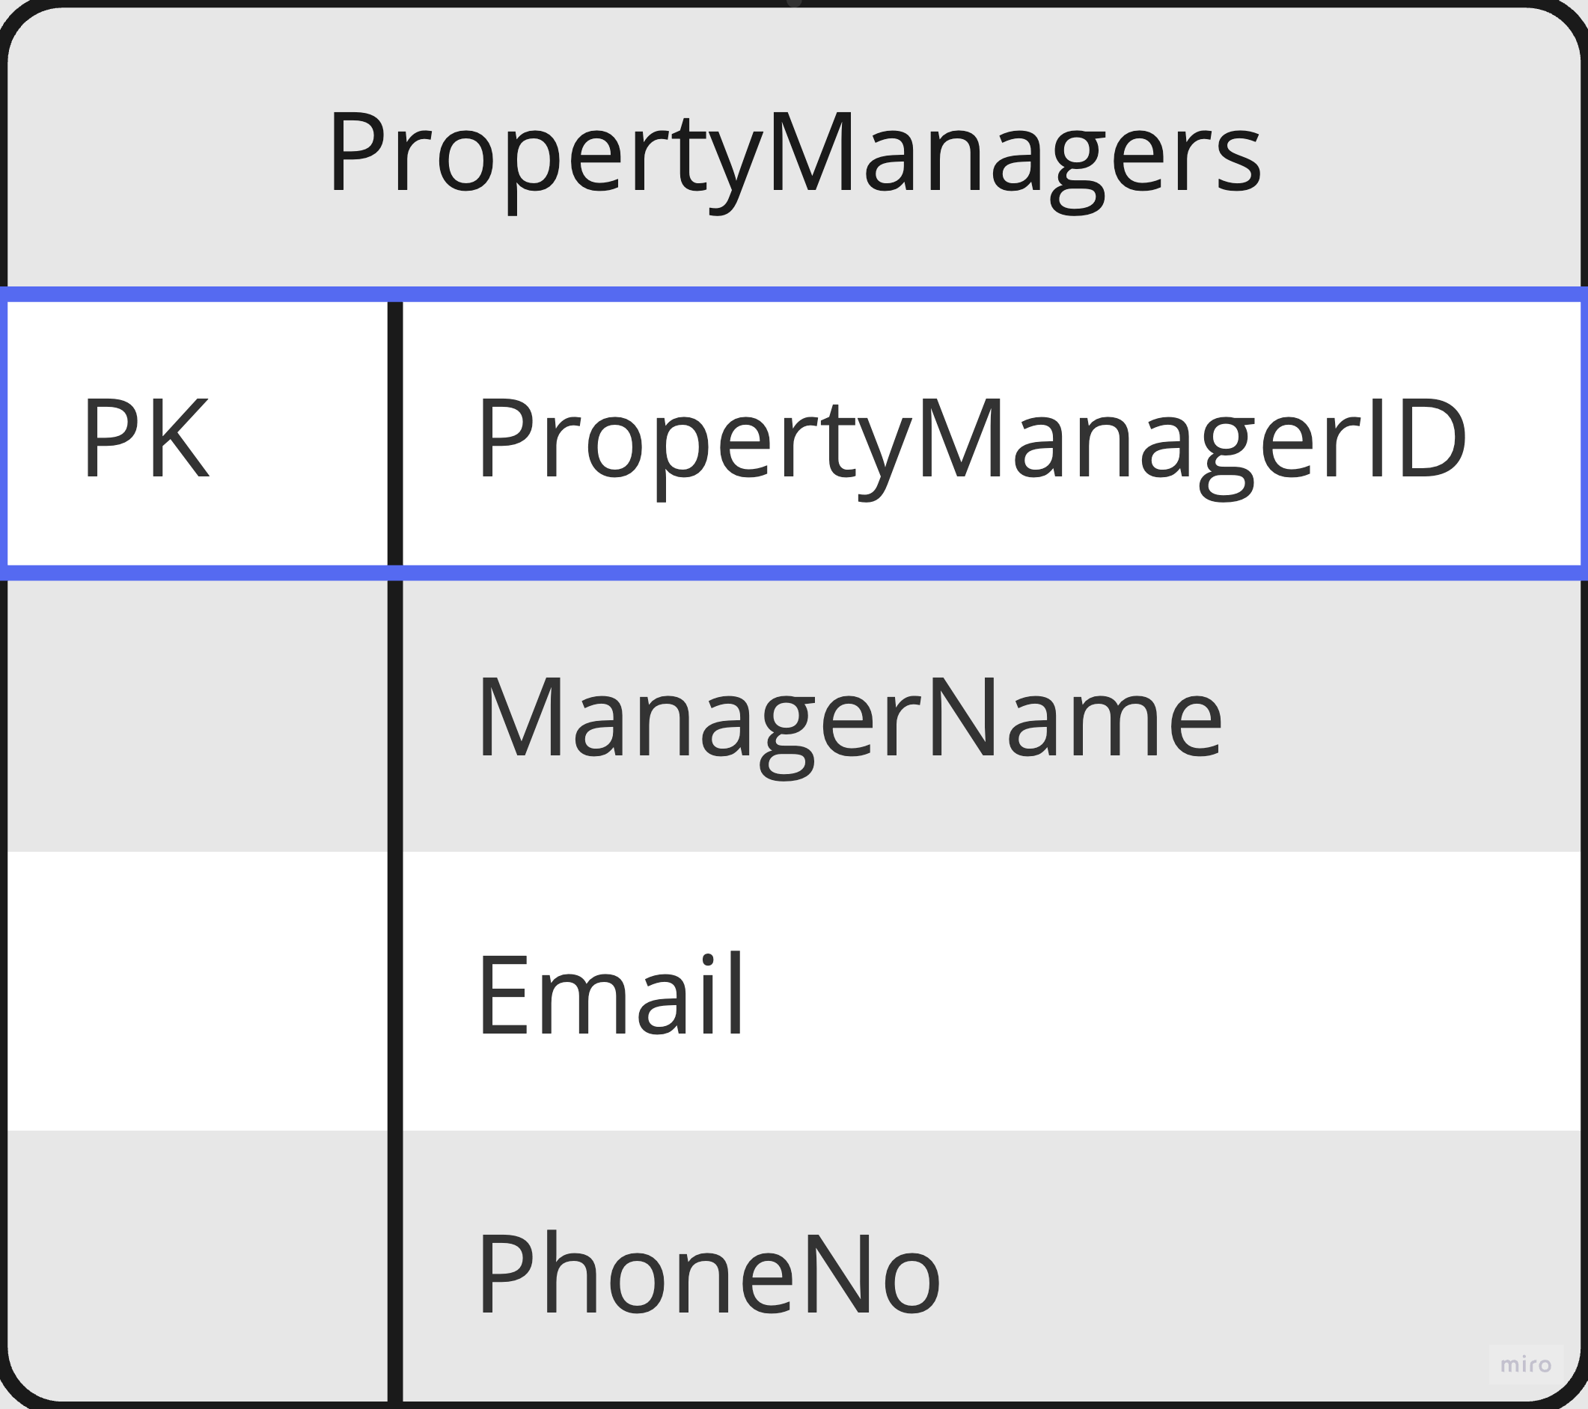
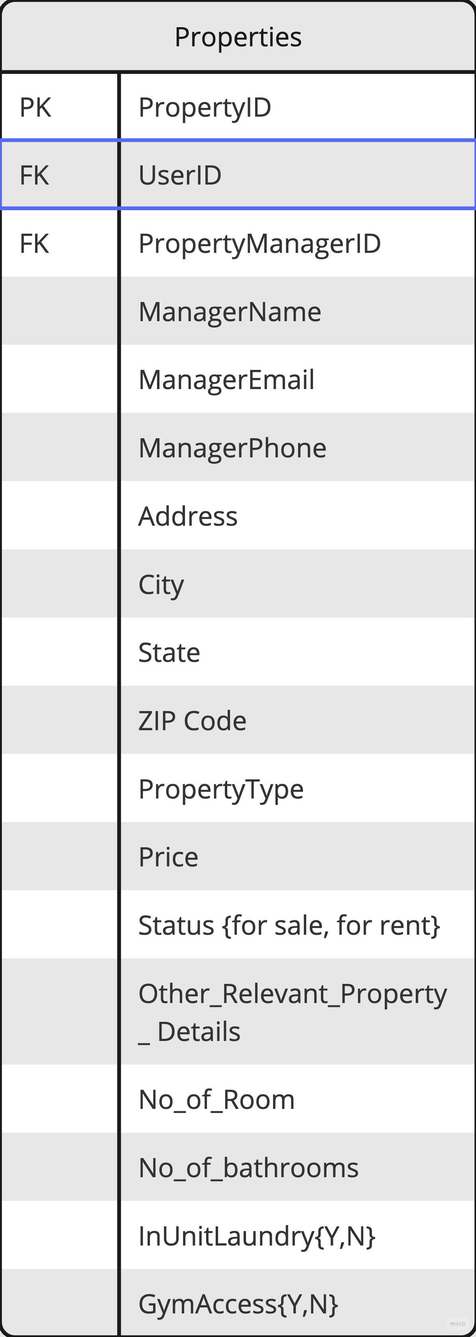
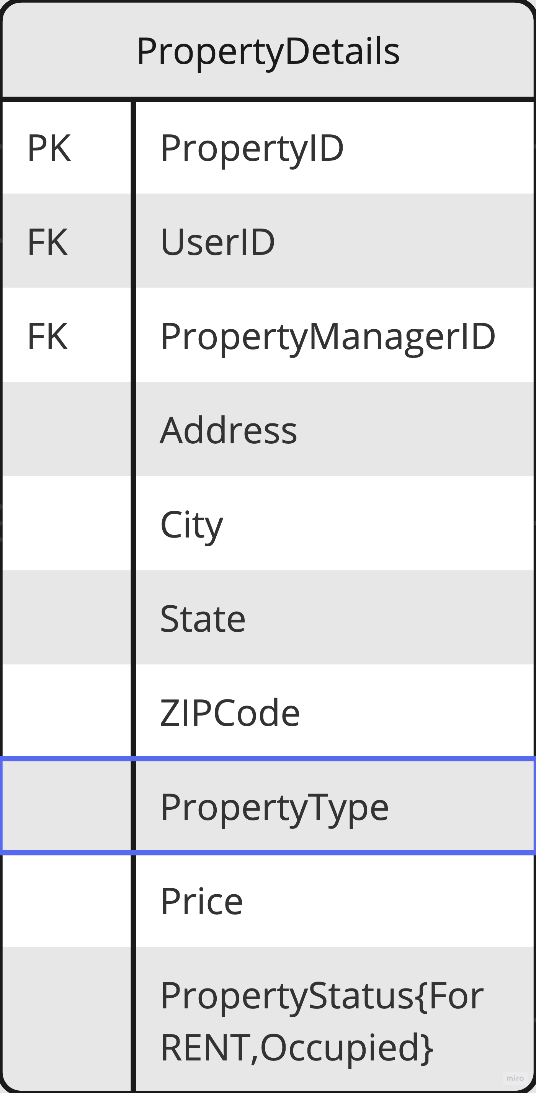
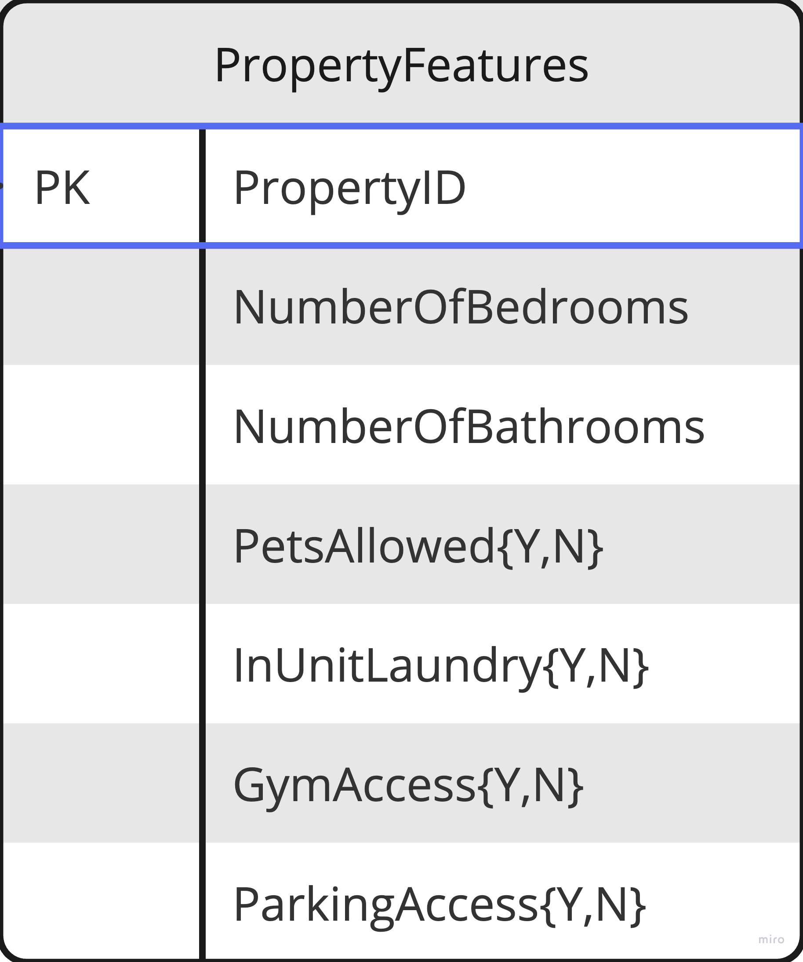

Slide 8
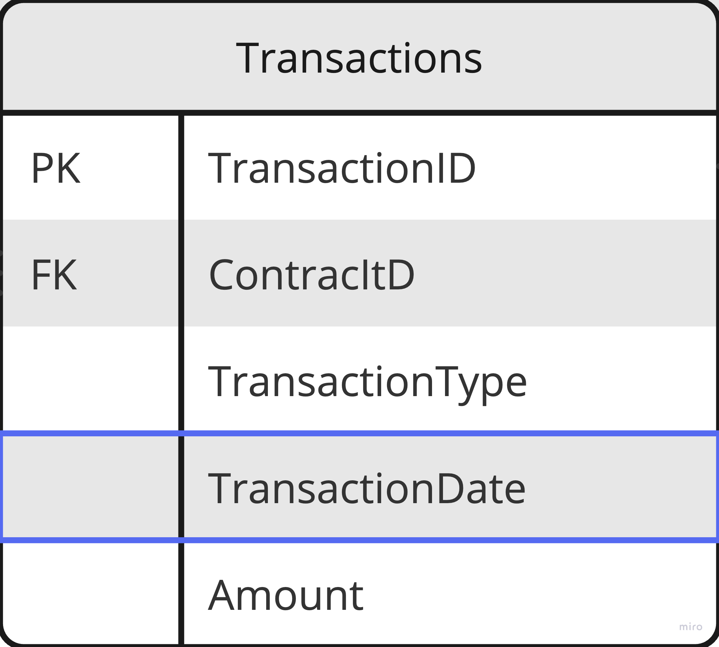
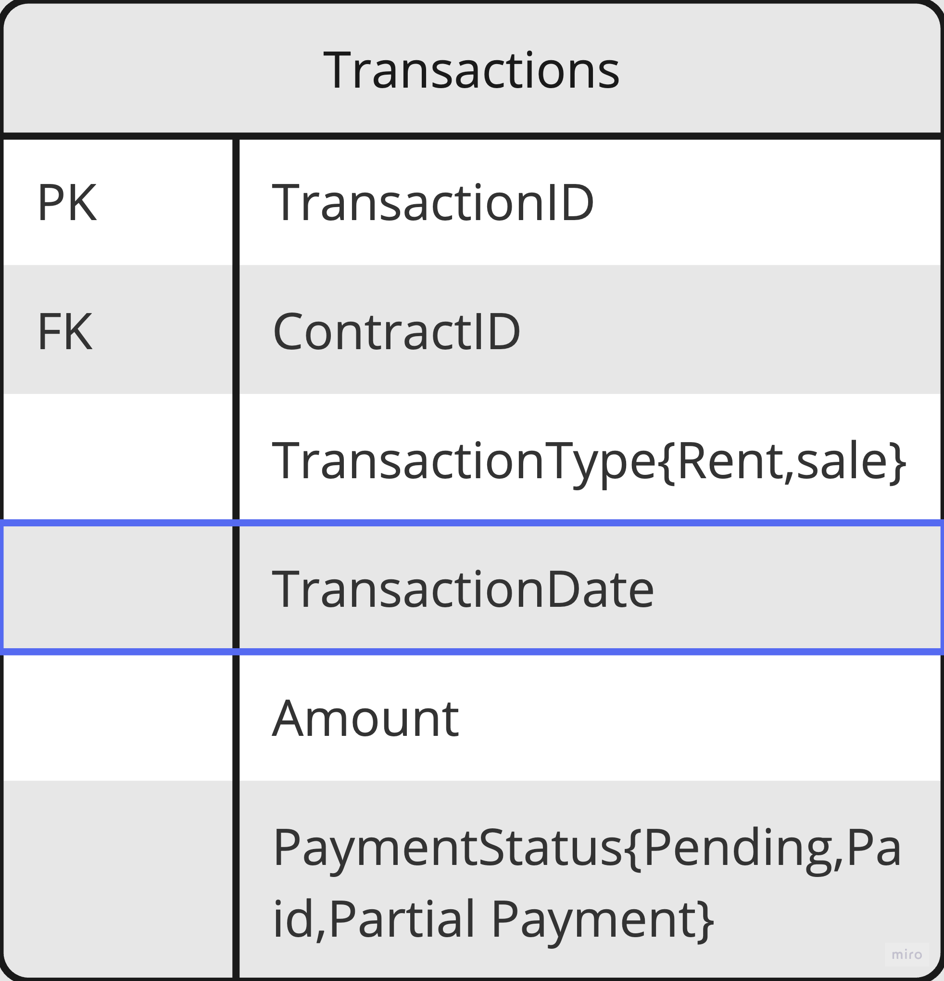
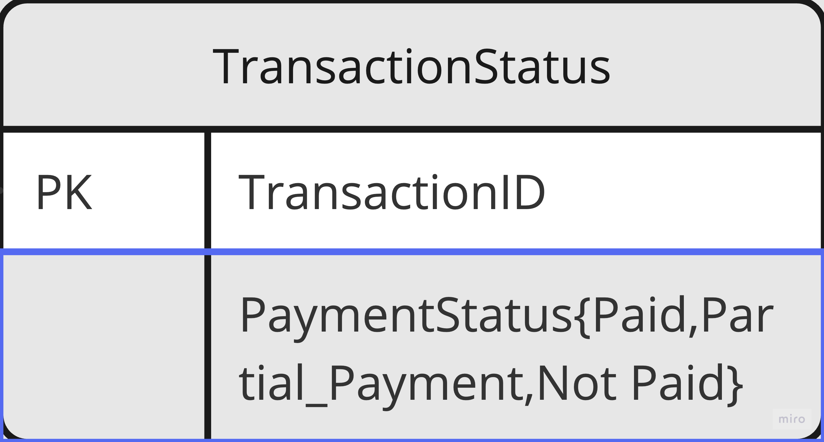

Slide 9
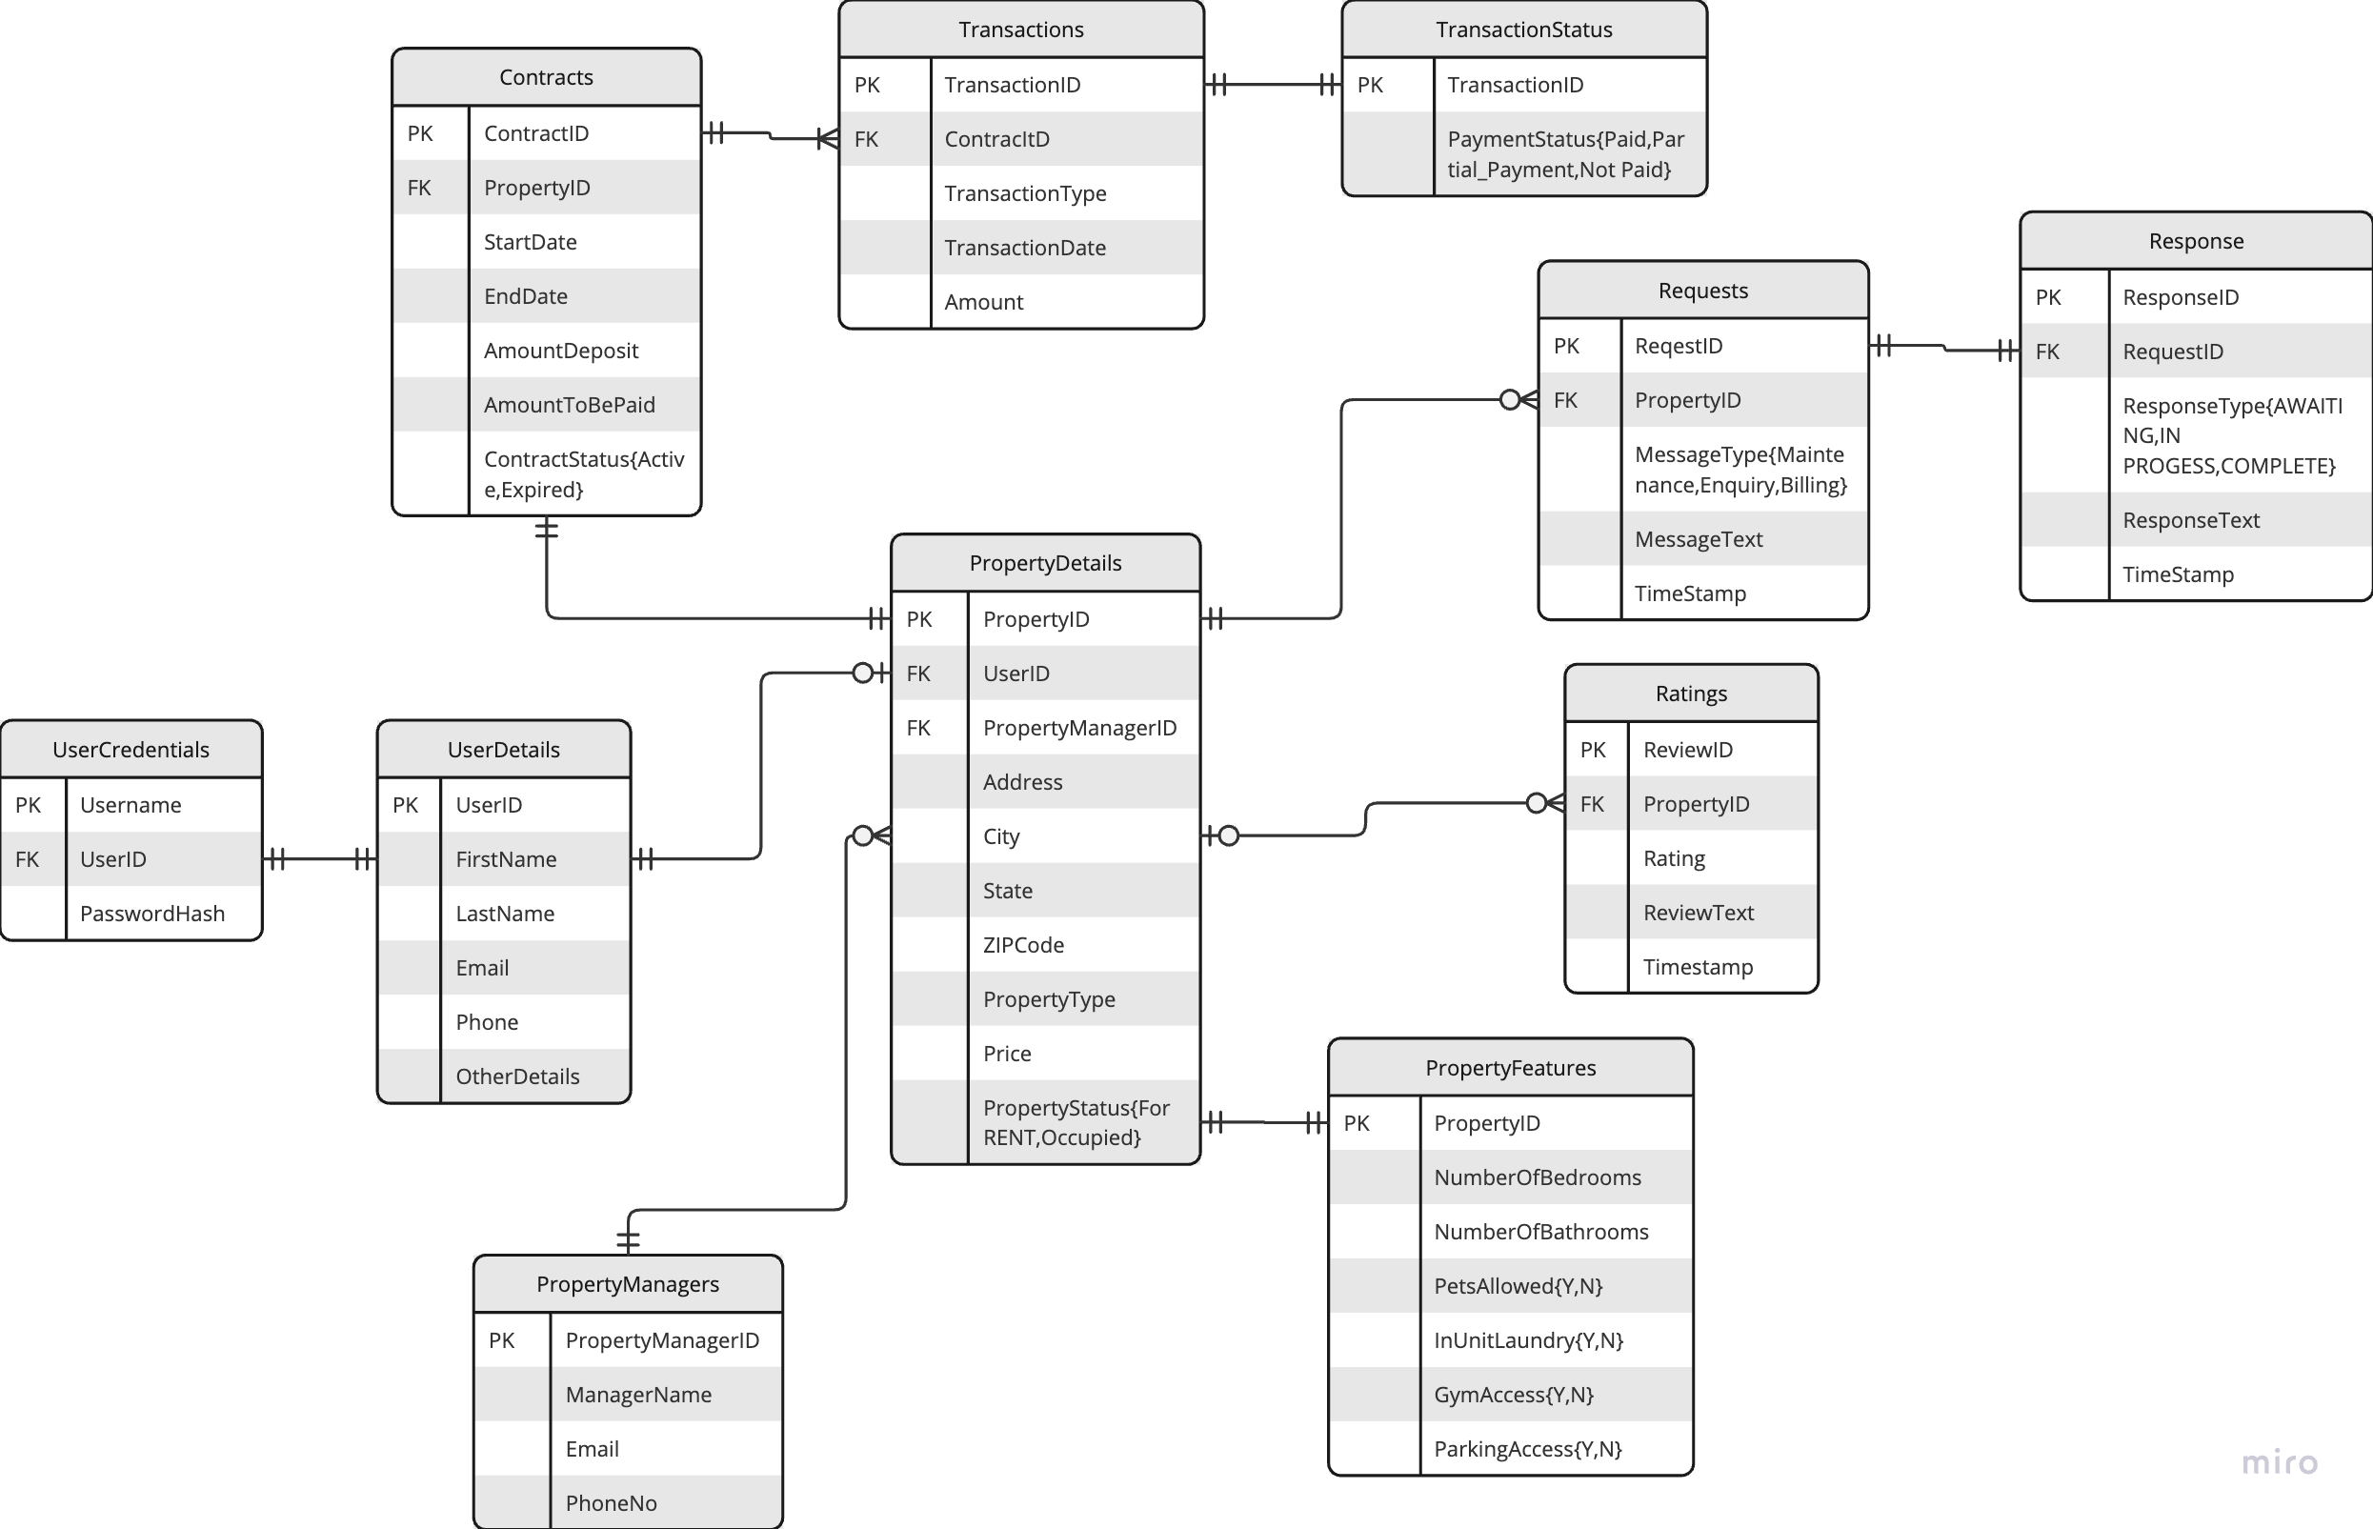
er DIAGRAM

Slide 10
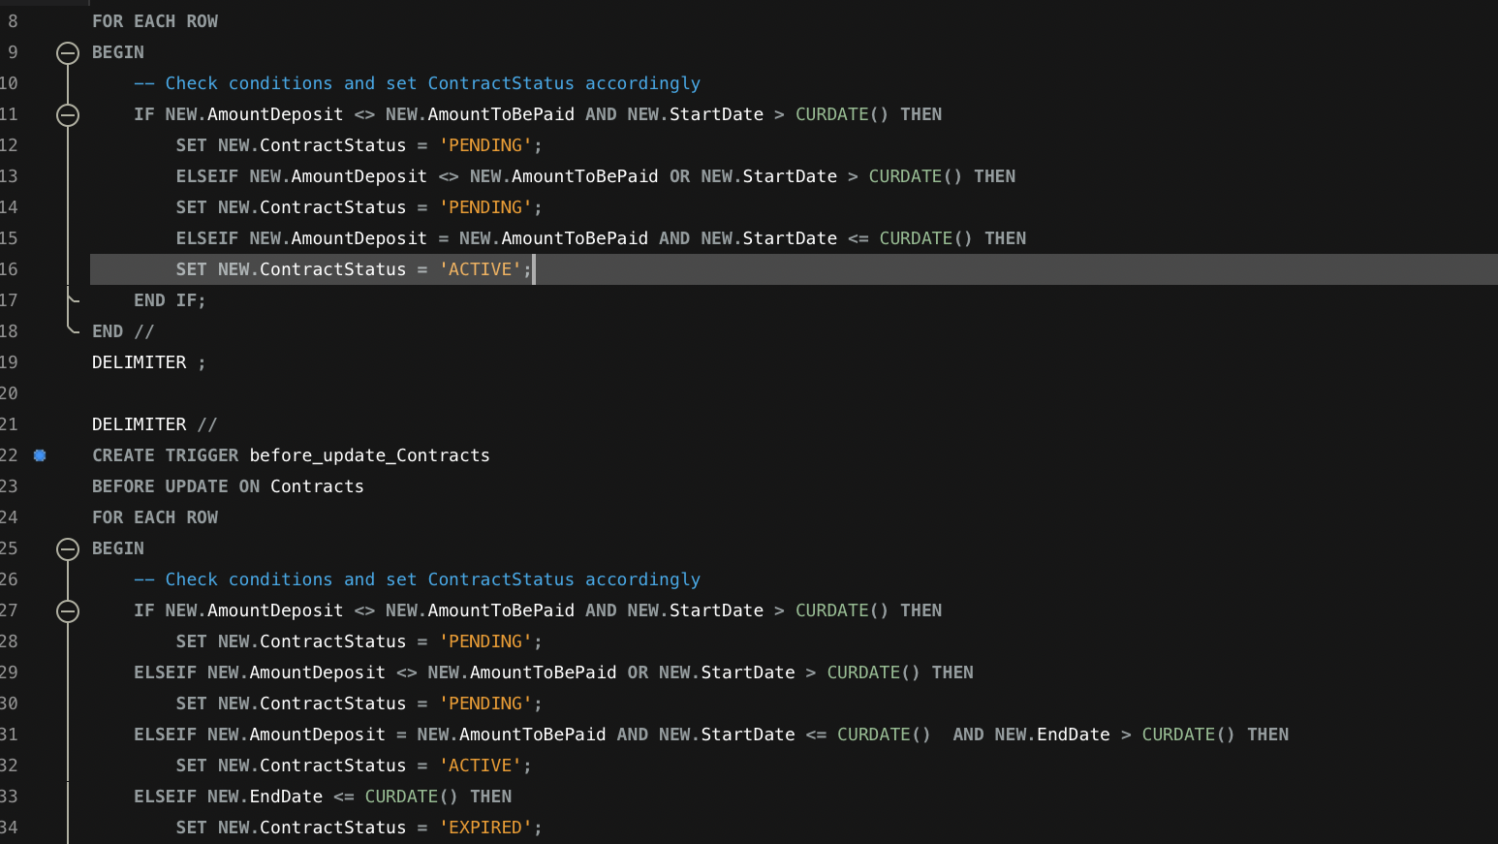
IMPORTANT TRIGGERS FROM THE Database

Slide 11
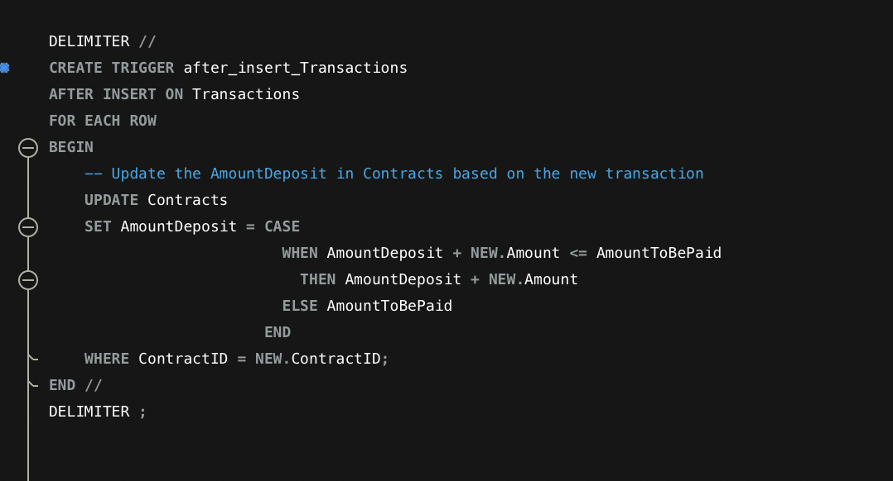

Slide 12
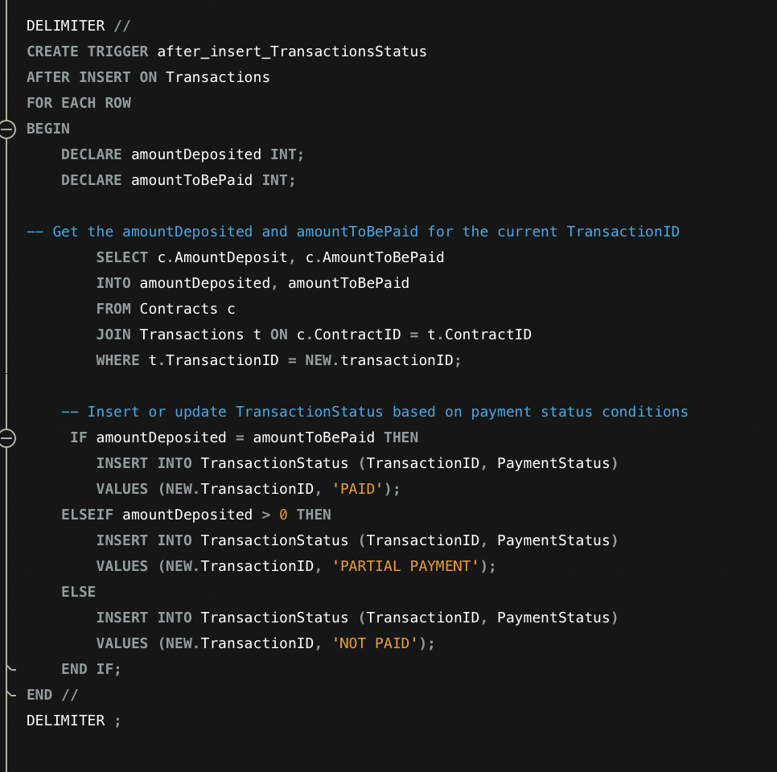

Slide 13
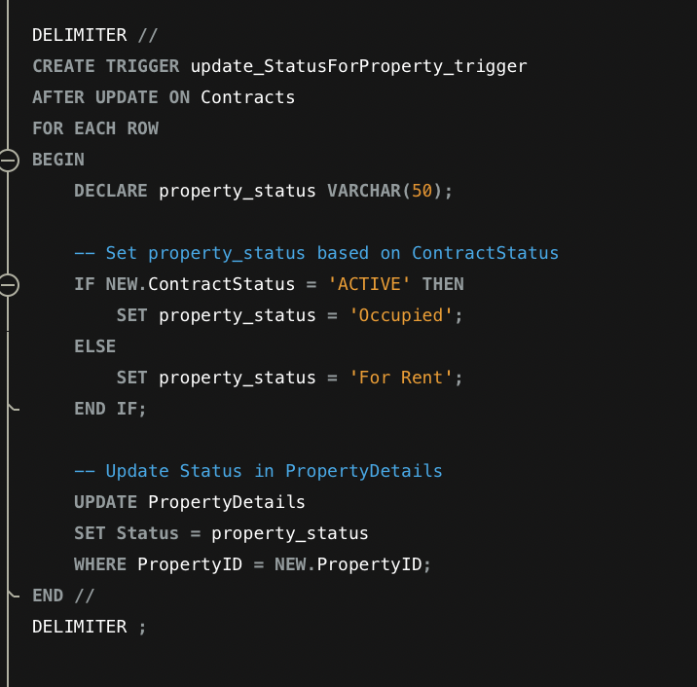

Slide 14
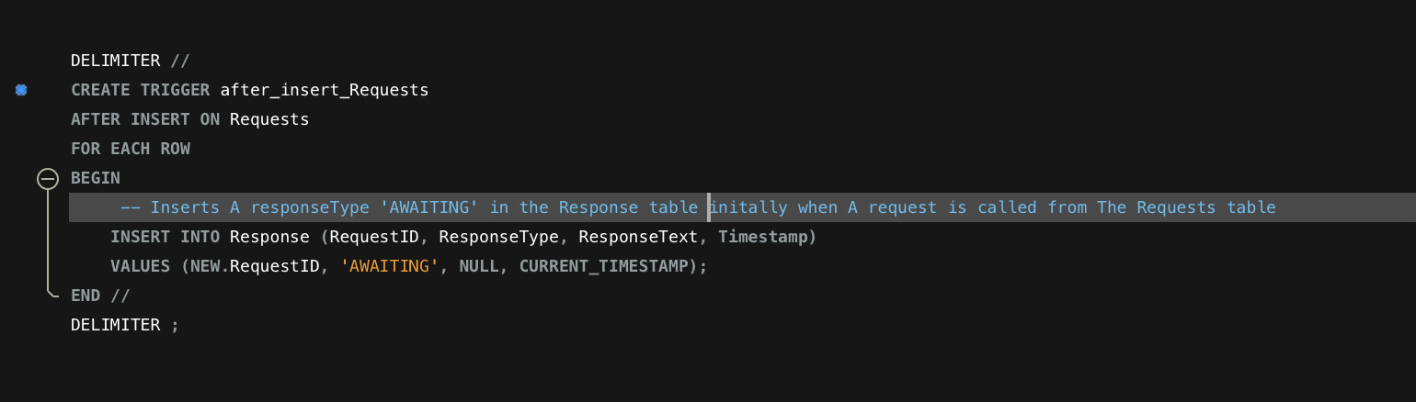

Slide 15
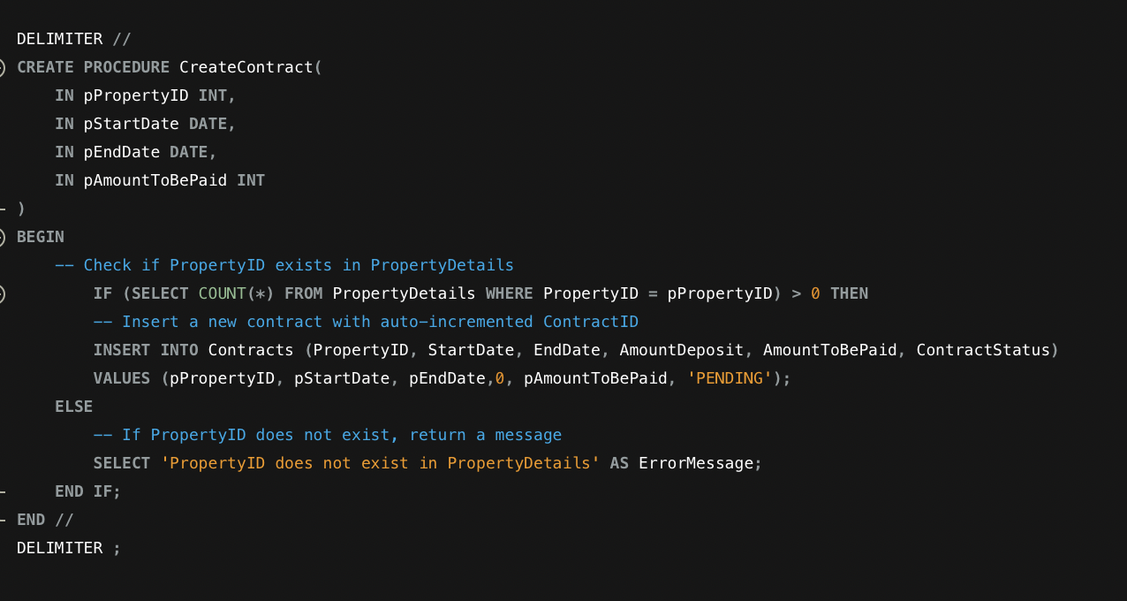
IMPORTANT STORED PROCEDURE

Slide 16
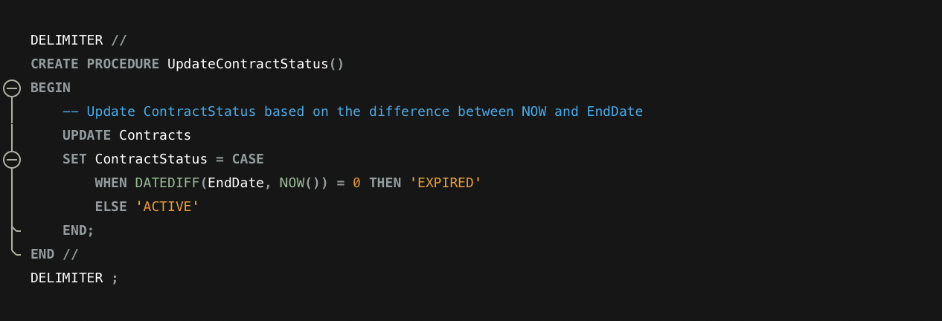

Slide 17
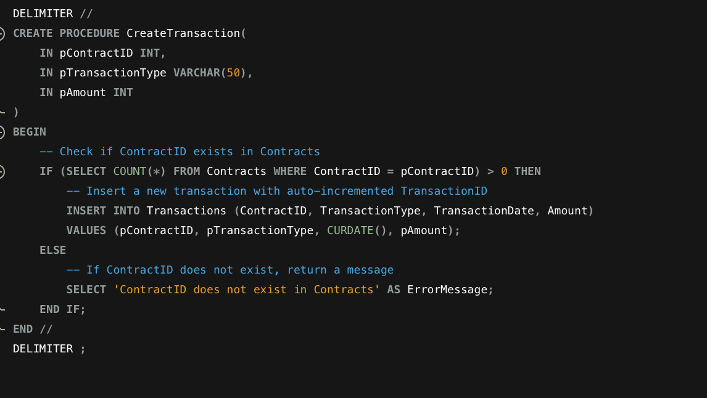

Slide 18
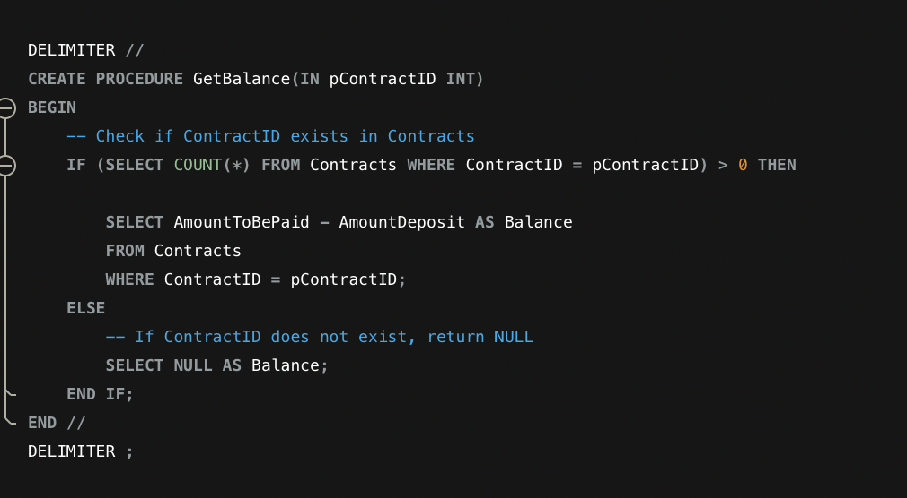

Slide 19
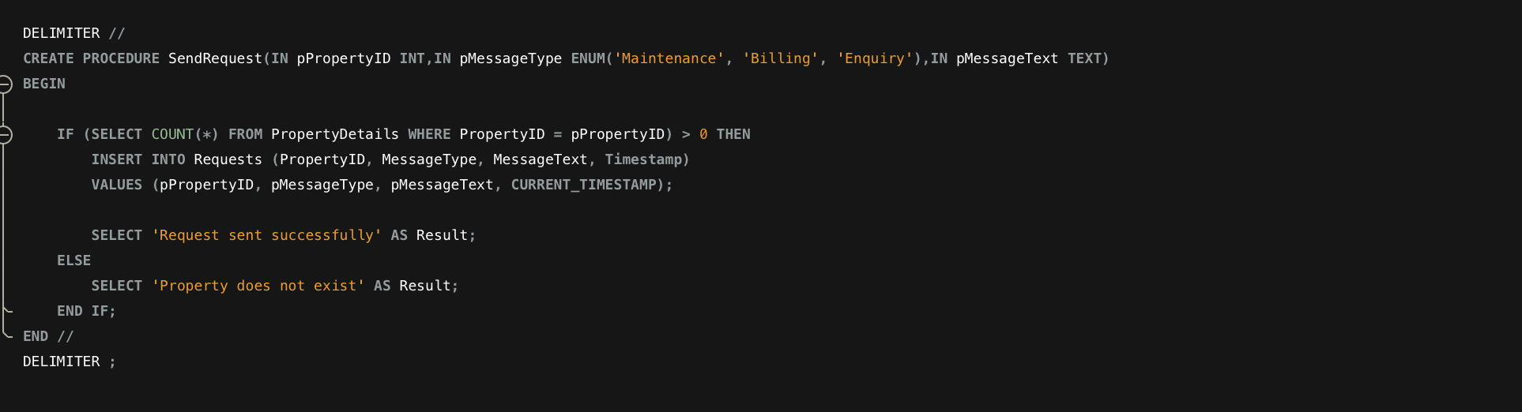

Slide 20
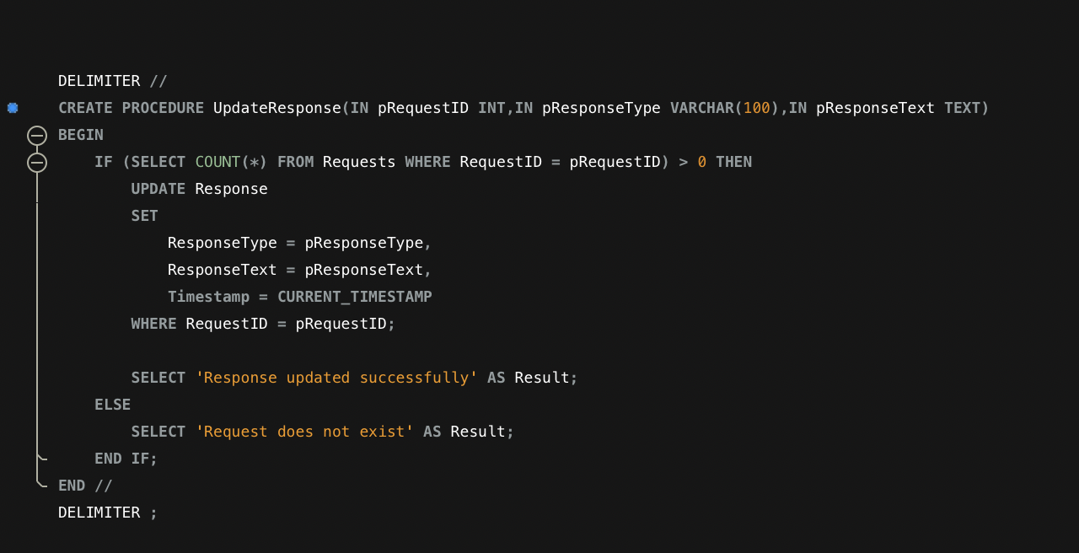

Slide 21
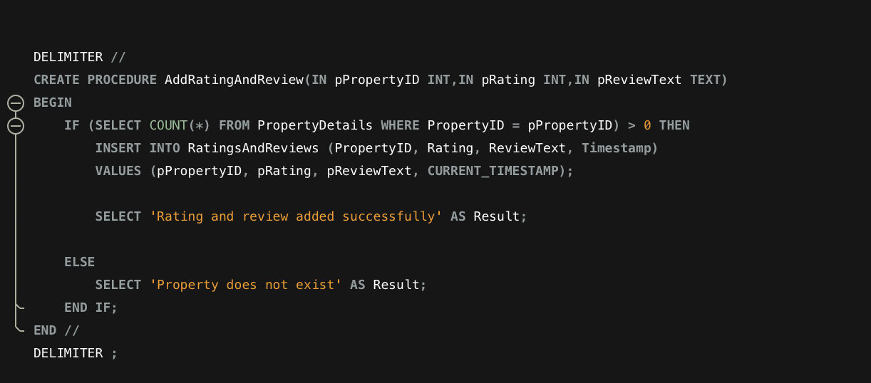

Slide 22
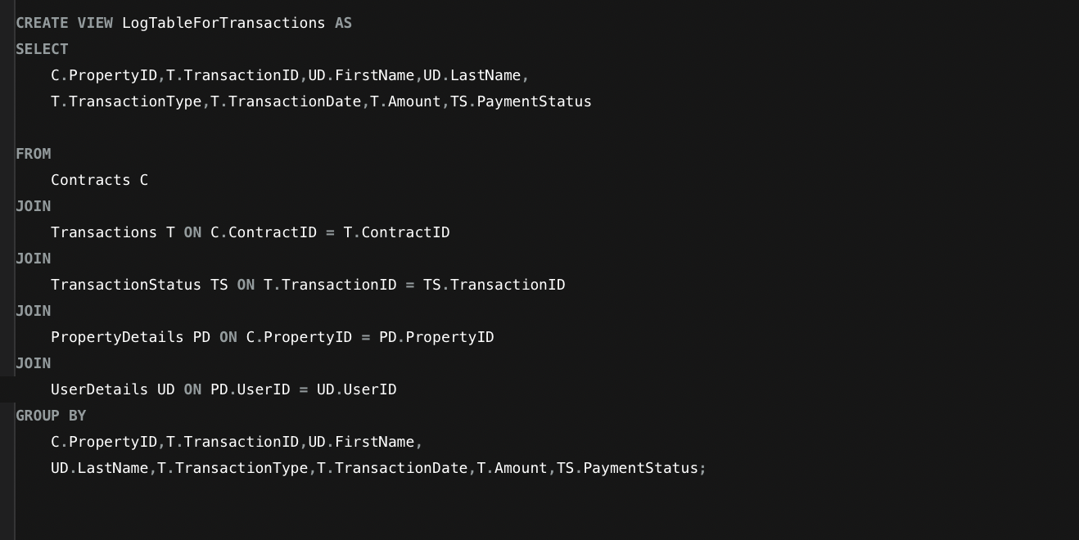
IMPORTANT VIEW TABLE

Slide 23
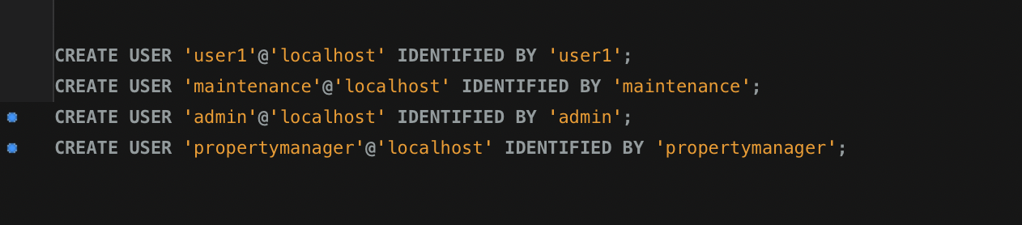
GRANTS FOR SPECIAL USER,ADMIN,MAINTENANCE,PROPERTY_MANAGERS

Slide 24
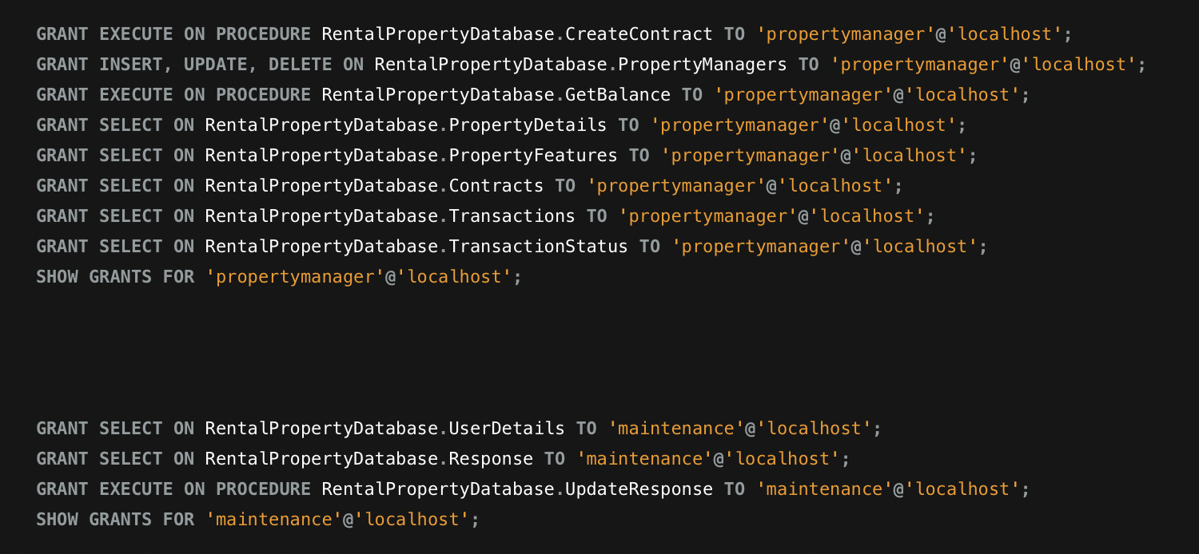

Slide 25
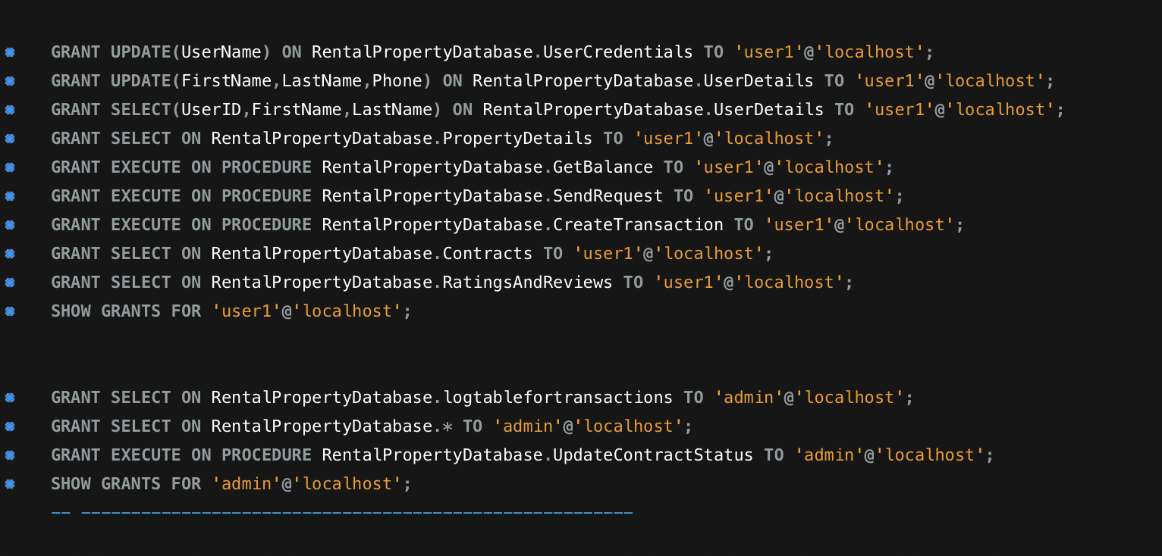

Slide 26
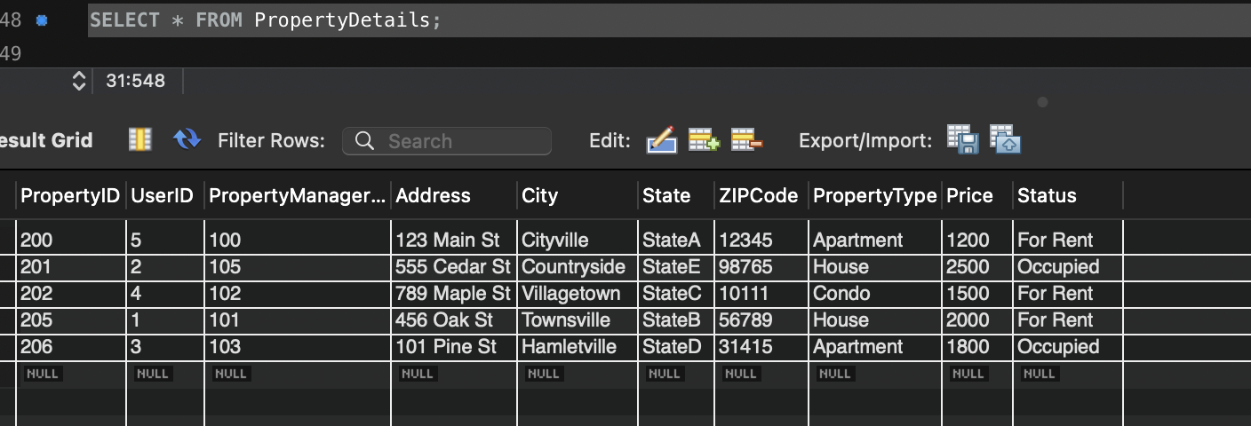
STEPS FOR OCCUPYING A PROPERTY AS A USER
Initially when a user wants to occupy a place a contract and transaction has to be made for such an action. Lets take PropertyID 202 for userID 4 in this case. STATUS SHOW User hasn’t occupied yet.

Slide 27
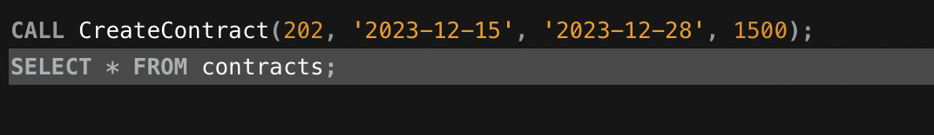
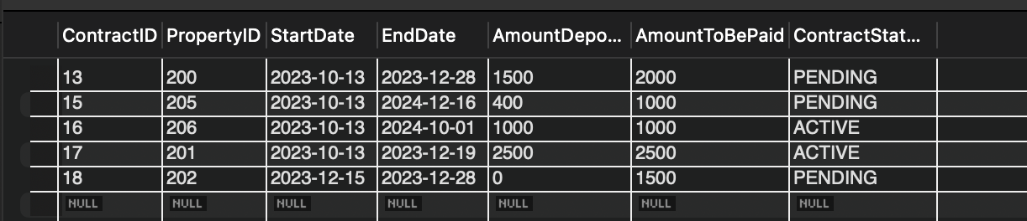
LET’S CREATE A CONTRACT as property manager
For this login as a property_manager(Refer to slide 23)
CALL CreateContract(202, '2023-12-15', '2023-12-28’, 1500);

Slide 28
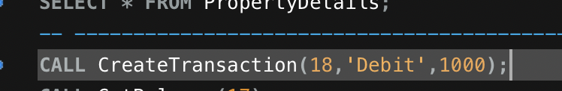
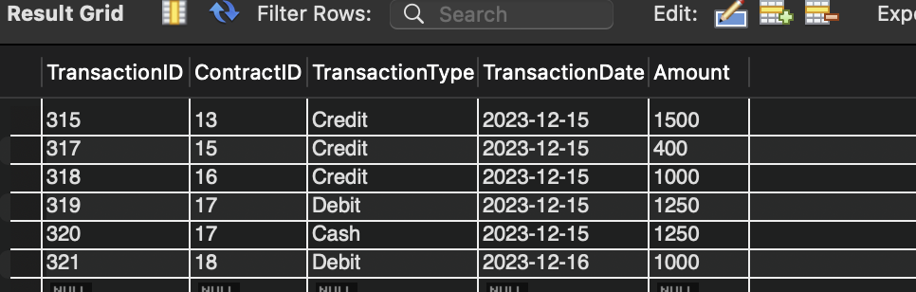
Let’s create a transaction as user
Login as user1 (refer to slide 23)
Since transaction is for ContractID 18 we will deposit an amount of ex: 1000

Slide 29
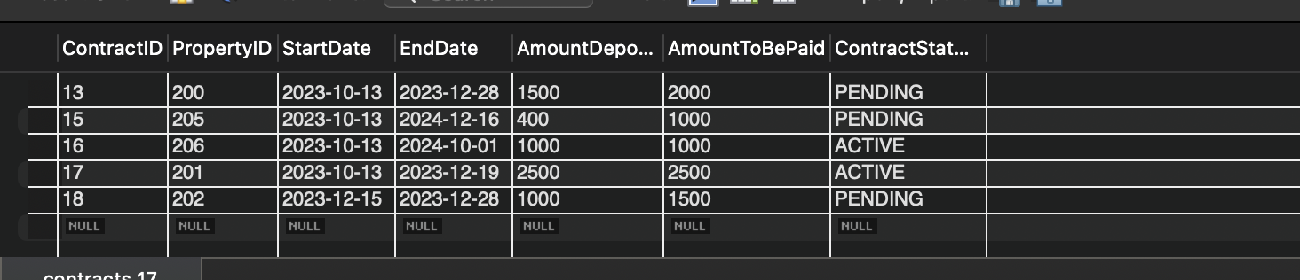
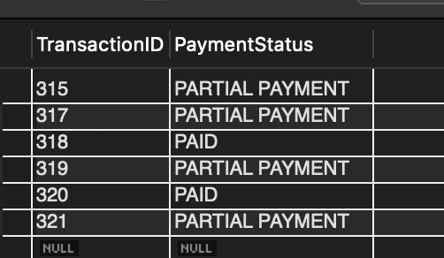
But in transaction status and contract tables it says…

Slide 30
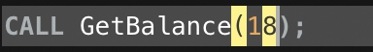
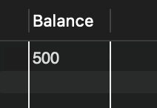
AS USER WE CAN CHECK THE BALANCE AMOUNT TO COMPLETE THE TRANSACTION AND START THE CONTRACT

Slide 31
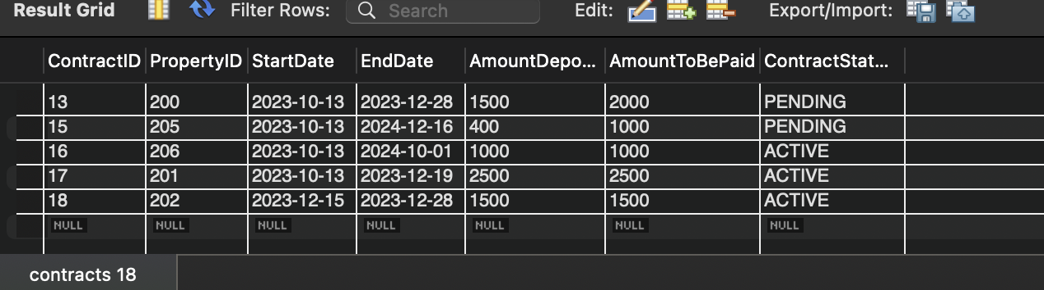
NOW WE PAY THE REMAINING BALANCE FOR THE CONTRACT TO OVERTURN..

Slide 32
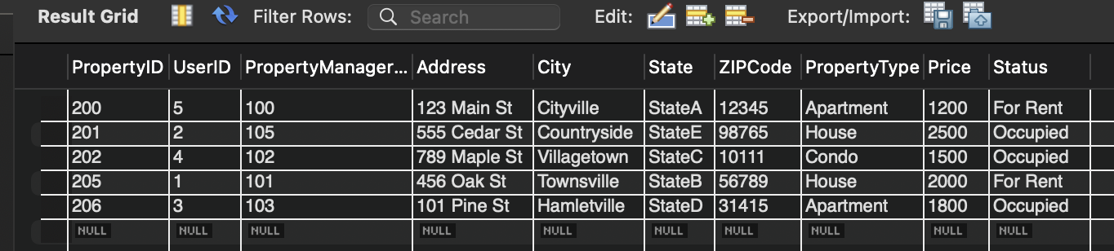
Once contract is ‘active’ user occupies the apt. for userid 4

Slide 33
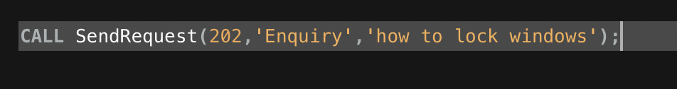
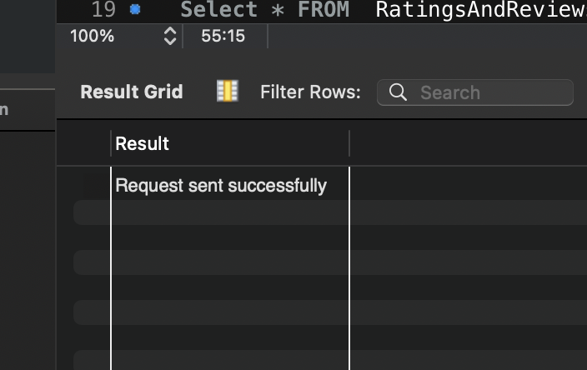
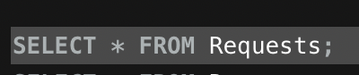
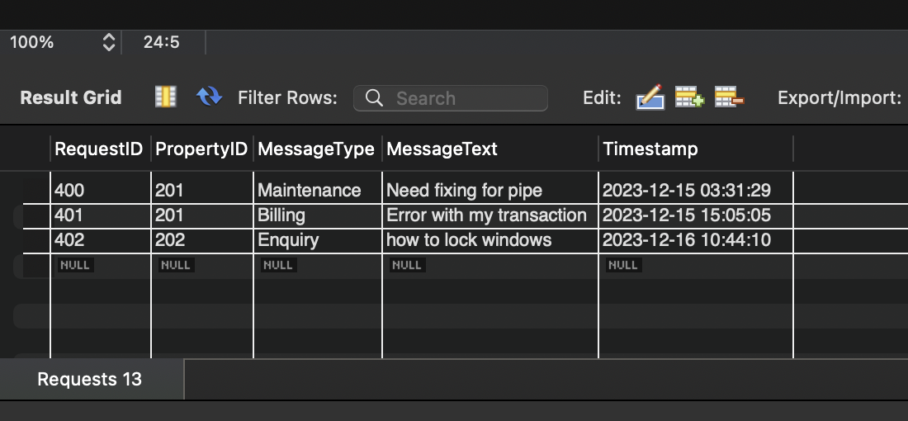
Steps for sending a request or enquiry as user1 FOR PROPERTYID 202

Slide 34
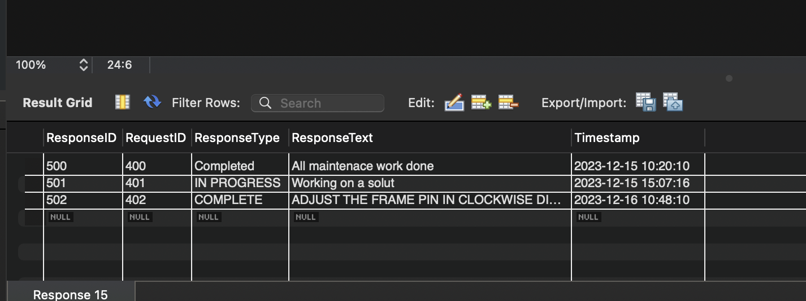
Responding to request as maintenance for requestid 402

Slide 35
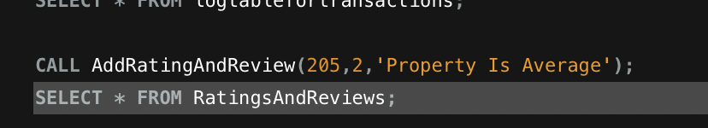
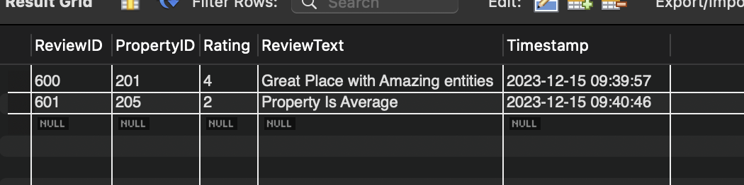
ADDING RATINGS AND REVIEW AS USER FOR PROPERTYID 205

Slide 36
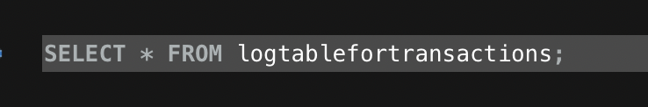
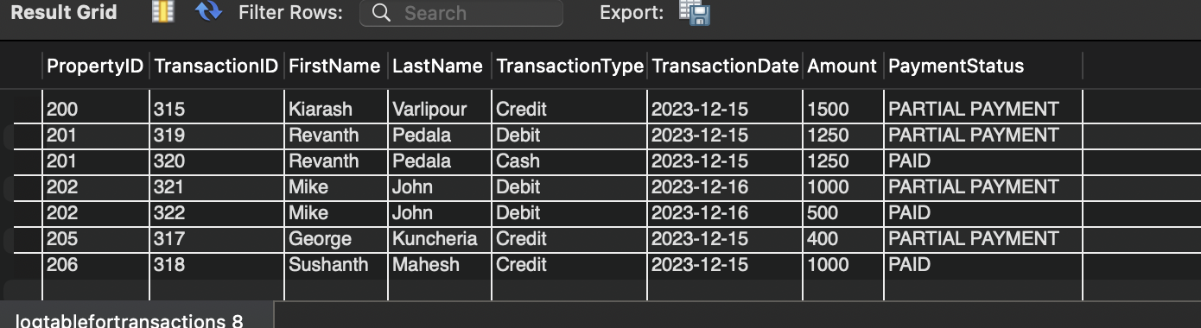
As ‘admin’ he can analyze the entire log table for the transaction, which property and who lives in the property (using a view table)

Slide 37
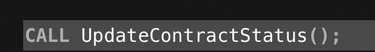
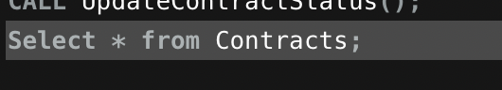
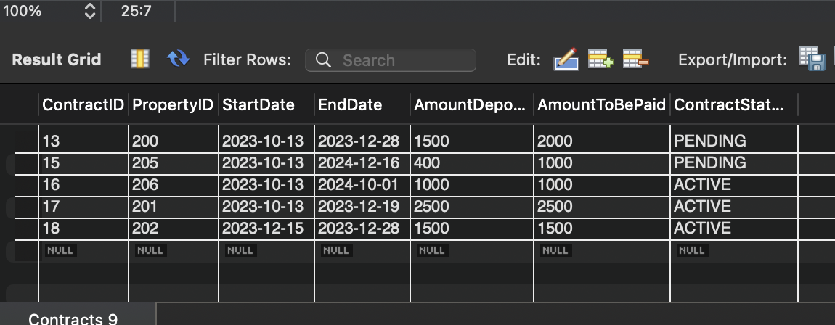
AS ’ADMIN’ YOU CAN UPDATE THE ENTIRE CONTRACT TABLE TO CHECK IF ALL THE USERS CONTRACTS ARE ACTIVE OR EXPIRED
Basically checks whether the CURRDATE() is BEFORE OR AFTER endDate in the contracts table

Slide 38
REFERENCES
Zillow Website: https://www.zillow.com/
Trulia Website: https://www.trulia.com/

